Slide 1


INDIAN ELECTION - 2019
NAME-RAGHAVENDRA
BATCH NUMBER-DA153S15

Slide 2

AGENDA
INTRODUCTION
PROJECT OBJECTIVE
PROCEDURE
ANALYSIS
Conclusion

Slide 3
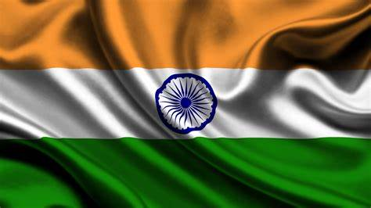
INTRODUCTION
THE ANALYSIS HERE IS BASED ON THE ELECTION OF LOK SABHA-2019, MEMBERS OF LOK SABHA ARE ELECTED BY BEING VOTED UPON BY CITIZENS OF INDIA.
CANDIDATES WHO WIN THE LOK SABHA ELECTIONS ARE CALLED ‘MEMBER OF PARLIMENT’.

Slide 4
OBJECTIVE
To conduct a comparative analysis of party performance in election across different states.
To analyze the relationship between a candidate's personal wealth and their political success
To analyze most important factors that influence a candidate's chance of winning

Slide 5
PROCEDURE
Step 1: Data Collection DATA IS DOWNLOADED FROM :
HTTPS://WWW.KAGGLE.COM/DATASETS/PRAKRUTCHAUHAN/INDIAN-CANDIDATES-FOR-GENERAL-ELECTION-2019
Step 2 : Importing all required packages
Step 3 : Importing data into jupyter note book.
Step 4 : Data Understanding & Data Warmup
Step 5 : Data Cleaning
Step 6 : Checking for null values
Step 7 : Missing value value treatment

Slide 6
Step 08 : Category & Numeric columns separation
Step 09 : Univariate analysis & Outlier Treatment
Step 10 : Bivariate Analysis
Step 11 : Multivariate analysis
Step 12 : Exporting Data to csv files
Step 13 : Conclusion

Slide 7

SQL
Step 1 : Data is downloaded from jupyter notebook
Step 2 : Open Mysql work bench
Step 3 : Click upon Create new schema icon and create new schema for data
Step 4 : Click upon Refresh Database
Step 5 : In navigation , inside new created database Right click on table
Step 6 : Click Table data import Wizard
Step 7 : Choose path of file and cick next , again click next.
Step 8 : Check datatype of each column and Click upon finish option to Import csv sheets into SQL table
Step 9 : Used select statements , group by , order by, limit clause ,
Aggregated functions to do analysis.

Slide 8
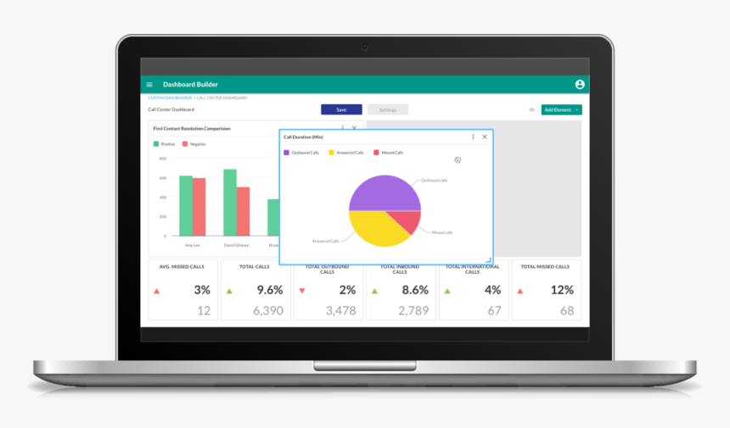
Tableau
Step 1 : Cleaned Data is downloaded from python jupyter notebook , data is in csv file format
Step 2 : As data is in CSV file, we click upon text file option to load data to tableau
Step 3 : Click upon Sheet 1 to go to workbook.
Step 4 : Graphs plotted
Step 5 : Template is designed using Figma
Step 6 : Interactive Dashboard is created.

Slide 9

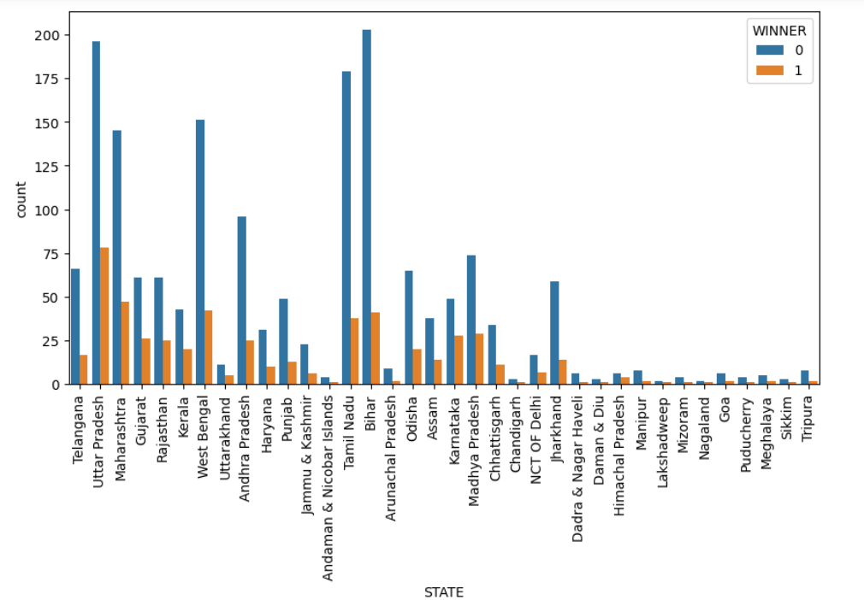
What is the winner and looser ratio according to states ?
Conclusion: In 2019 2246 candidates contested in election ,UP has more winners and BIHAR has less winners

Slide 10
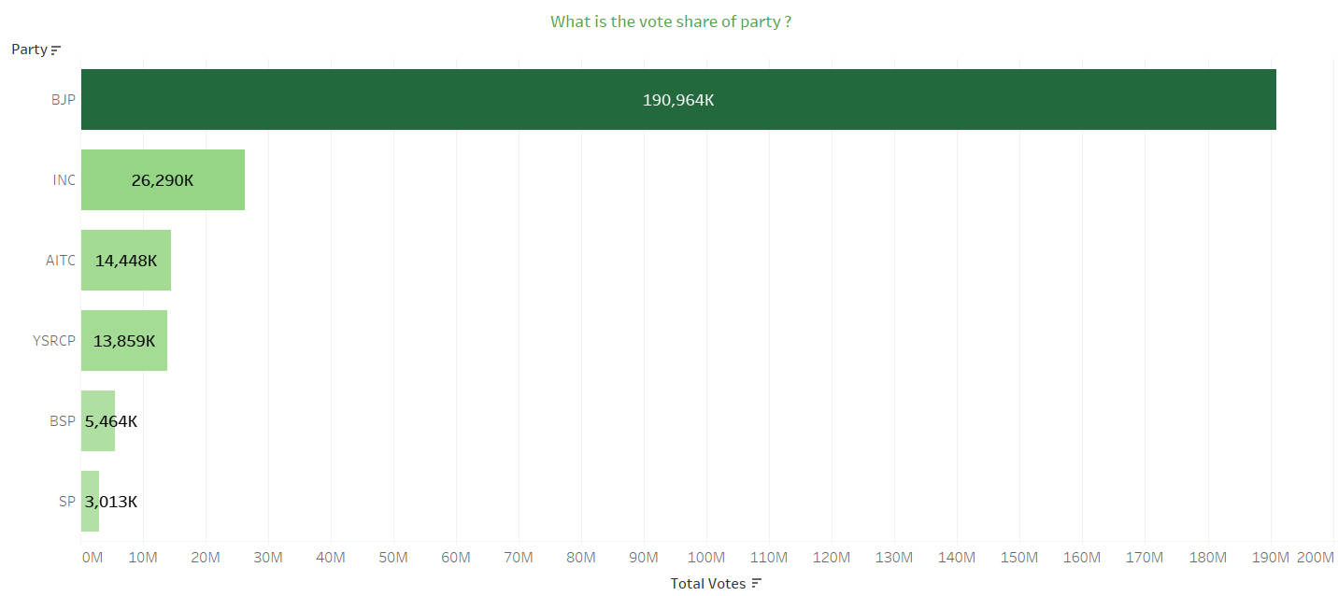
What is the Vote share of party?
Conclusion : BJP has more votes

Slide 11
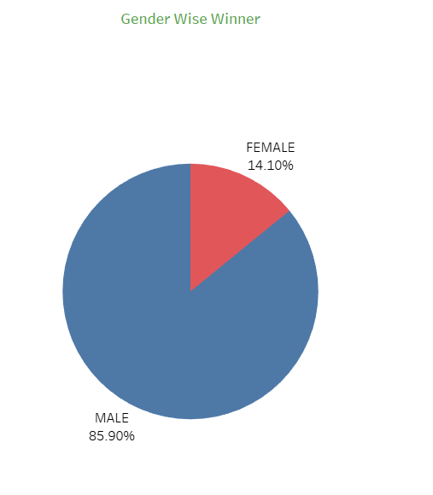
Most of winner belongs to which gender?
Conclusion: Most of the winners are male i.e 85%

Slide 12
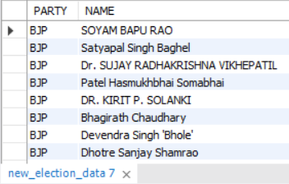
Display List of winning candidates?
Conclusion: Soyam Bapu rao , Satyapal singh baghel are some of the winning M.P

Slide 13
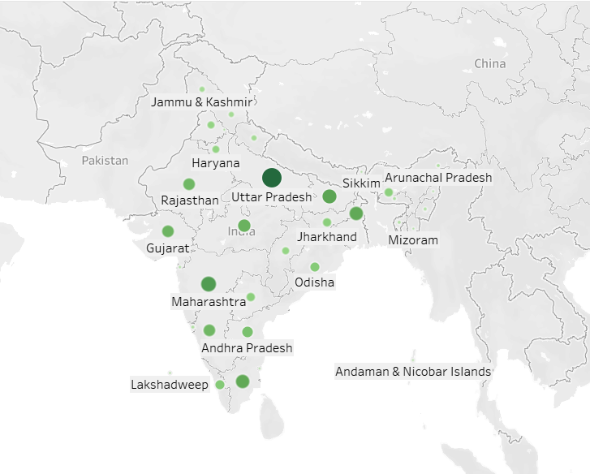
Which state has polled more votes?
Conclusion : Many Citizens from Uttar Pradesh has polled more votes

Slide 14
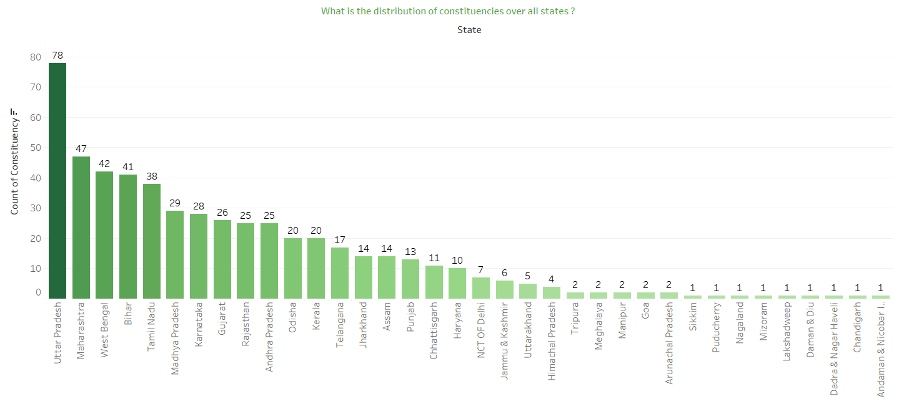
What is the distribution of constituencies all over states?
Conclusion: U.P has secured many seats in election.

Slide 15
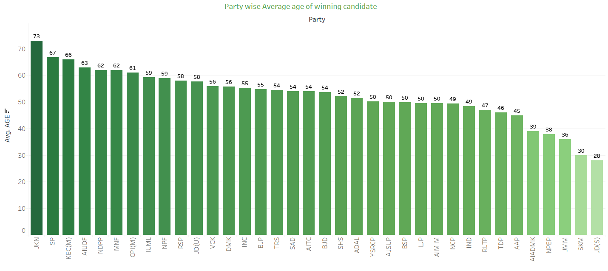
What is the average age of winning candidate in each Party ?
Conclusion: Youngest M.P are from JD(s) and oldest M.p are from JKN party

Slide 16
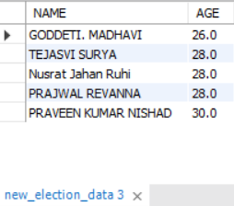
Who are Top 5 youngest MP in India ?
Conclusion : The top 5 youngest MP are GODDETI. MADHAVI,TEJASVI SURYA ,Nusrat Jahan Ruhi , PRAJWAL REVANNA,PRAVEEN KUMAR NISHAD

Slide 17
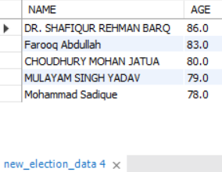
List the Top 5 Oldest MP in India ?
Conclusion :Top 5 oldest MP are DR. SHAFIQUR REHMAN BARQ, Farooq Abdullah , CHOUDHURY MOHAN JATUA,MULAYAM SINGH YADAV , Mohammad Sadique.

Slide 18
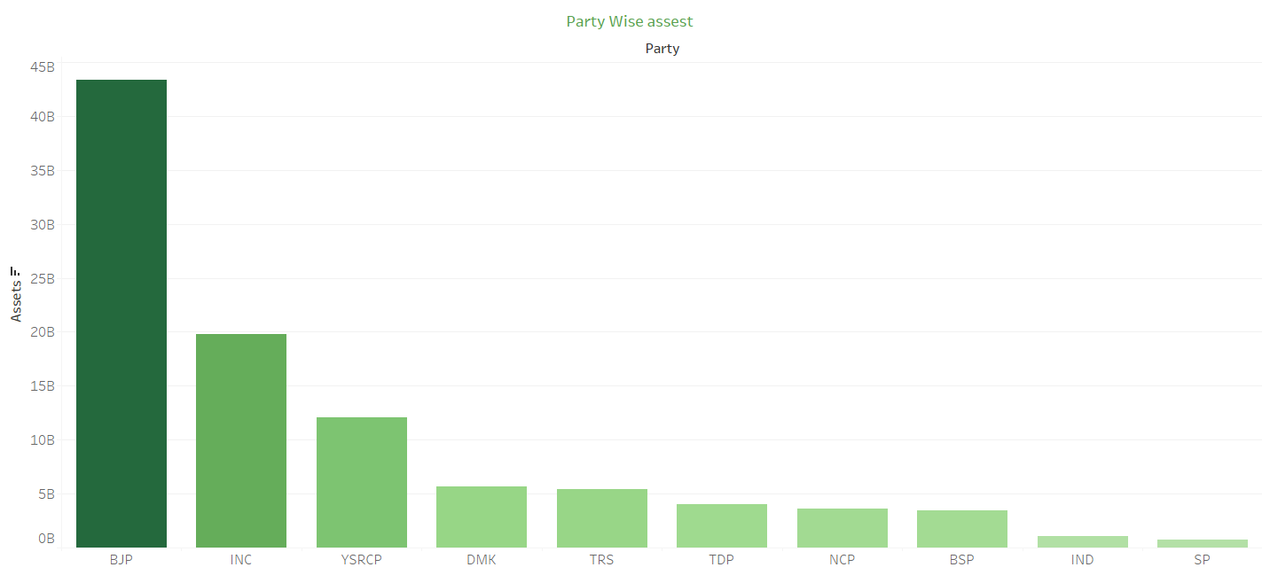
Which party has more assets?
Conclusion: BJP Party has more assets.

Slide 19
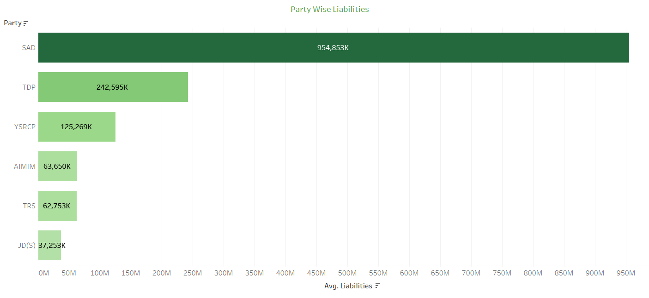
Which party has more liabilities?
Conclusion: SAD party has more liabilities

Slide 20
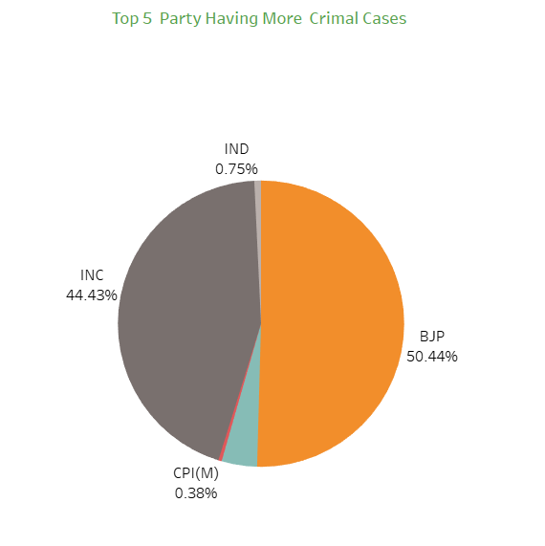
Which party has committed more criminal activity?
Conclusion: BJP Party has committed more criminal activity

Slide 21
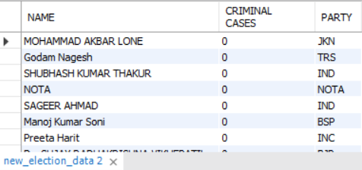
which candidate has not committed any criminal cases
Conclusion : output shows the list of candidates with no criminal cases

Slide 22
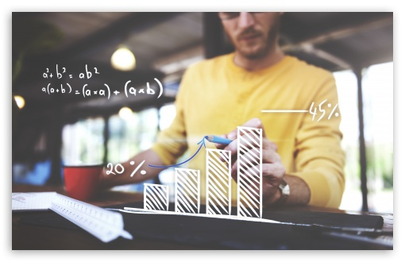
Analyzing the factors that impact candidates chance of winning

Slide 23
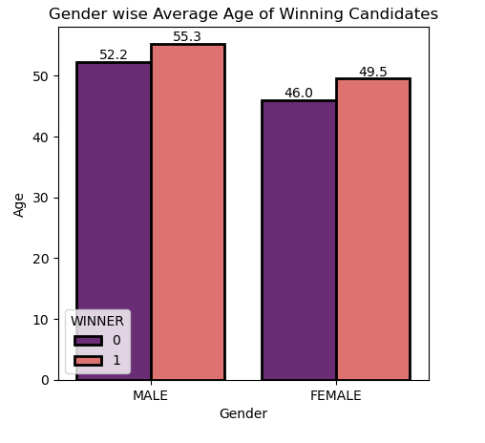
What age requirements should be in place for gender-wise winning candidates?
Conclusion : Average age of Male should be:55, Average age of Female should be:49

Slide 24
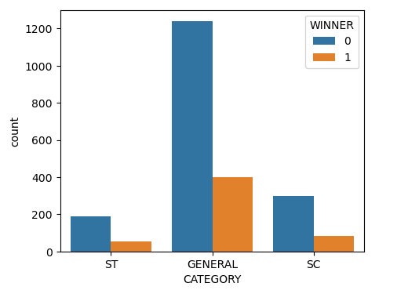
Winning candidate should belong to which category ?
Conclusion : Most of the winning candidates belong to General category

Slide 25
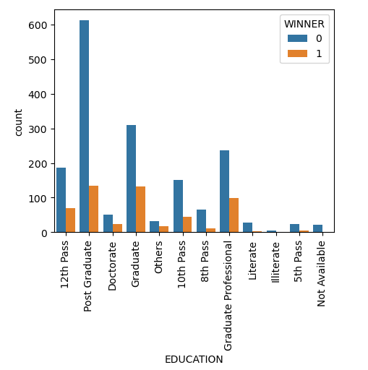
What educational qualifications should the winning candidate possess?
Conclusion : Most of the winning candidates are graduates.

Slide 26
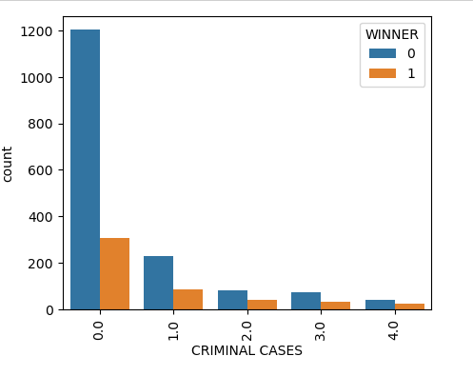
What is the maximum number of criminal cases that a winning election candidate can have?
Conclusion : Winner should have zero criminal cases

Slide 27
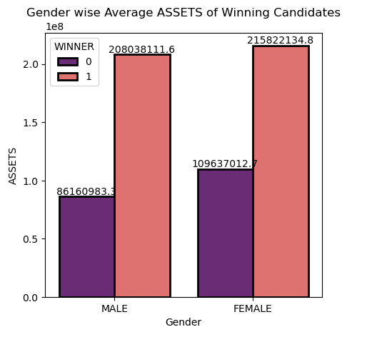
What assets should the winning candidates of the Lok Sabha election have, gender wise?
Conclusion: Male should have 208038111 and Female should have 215822134 assets to win election

Slide 28
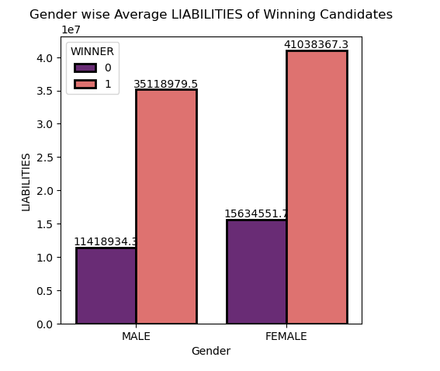
What should be the liability of the male and female winning candidate of the MP election?
Conclusion: Male should have 35118979 and Female should have 41038367 liability to win election

Slide 29
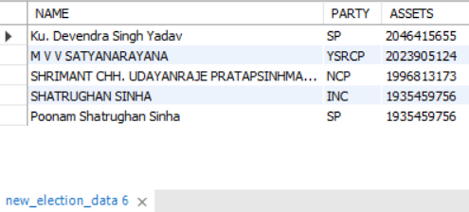
Who are Top 5 Richest MP in India ?
Conclusion : Richest M.P are Ku. Devendra Singh Yadav,M V V SATYANARAYANA,SHRIMANT CHH. UDAYANRAJE PRATAPSINHMAHARAJ BHONSLE,SHATRUGHAN SINHA,Poonam Shatrughan Sinha.

Slide 30
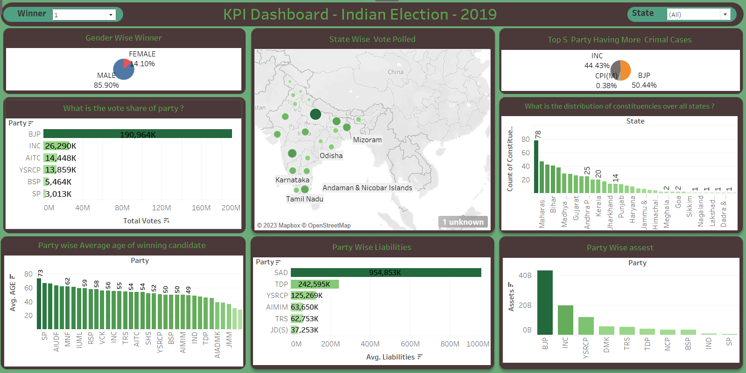
Dashboard
Link
Link1

Slide 31
Conclusion
BJP has more votes and won election.
Many Citizens from Uttar Pradesh has polled more votes.
U.P has secured many seats in election.
Youngest M.P are from JD(s) and oldest M.p are from JKN party
BJP Party has more assets.
SAD party has more liabilities
BJP Party has committed more criminal activity
Average age of Male should be:55, Average age of Female should be:49 to win election
Most of the winning candidates belong to General category
Most of the winning candidates are graduates.

Slide 32
Conclusion
Winner should have zero criminal cases
Male should have 208038111 and Female should have 215822134 assets to win election
Male should have 35118979 and Female should have 41038367 liability to win election
Richest M.P are Ku. Devendra Singh Yadav,M V V SATYANARAYANA,SHRIMANT CHH. UDAYANRAJE PRATAPSINHMAHARAJ BHONSLE,SHATRUGHAN SINHA,Poonam Shatrughan Sinha.
The top 5 youngest MP are GODDETI. MADHAVI,TEJASVI SURYA ,Nusrat Jahan Ruhi , PRAJWAL REVANNA,PRAVEEN KUMAR NISHAD
Top 5 oldest MP are DR. SHAFIQUR REHMAN BARQ, Farooq Abdullah , CHOUDHURY MOHAN JATUA,MULAYAM SINGH YADAV , Mohammad Sadique.

Slide 33
Suggestions
Candidates should not have any criminal cases to win election
Candidate should have more assets to win election
Candidates should be graduate to win election
Number of participation of female candidate in election has to be increased .

Slide 34
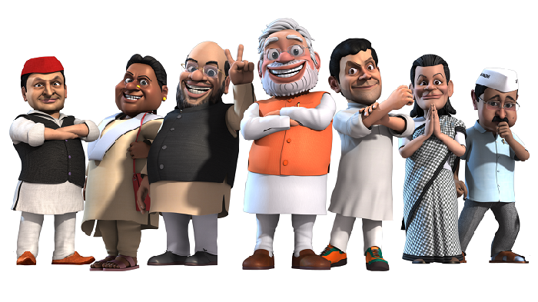
Thank You

